Slide 1


Connect with me
Twitter: @MrThomasRayner
LinkedIn.com/in/thomasrayner
workingsysadmin.com – I blog about PowerShell!
Check out my user group
Slides and Demo Script
https://github.com/ThmsRynr/Presentation-Files
@EMUGca - Emug.ca

Slide 2
Why do you want to write non-sucky PowerShell?
Be nice to the next guy
Sharing is caring
Scripting is a craft
You’re a professional
If it’s worth doing, it’s worth doing right
This is not a comprehensive guide. Just 6 things you should do.

Slide 3
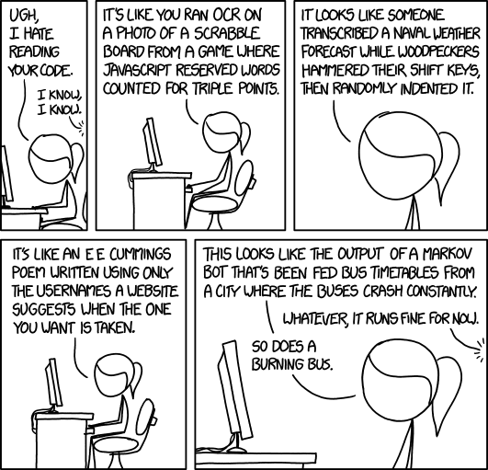
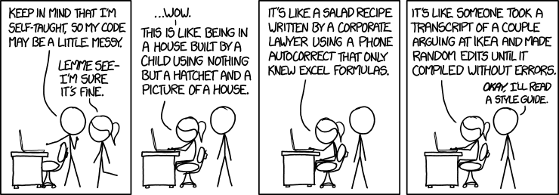
Why do you want to write non-sucky PowerShell?
http://xkcd.com/1513/ https://xkcd.com/1695/

Slide 4





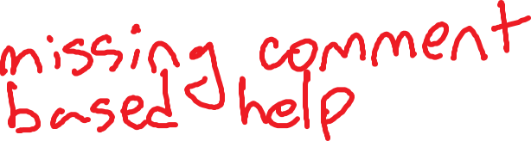
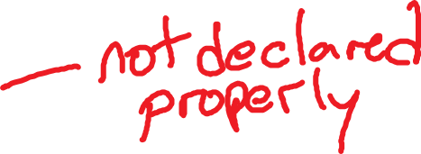
Naming Stuff - Functions
Consider the following PowerShell
function filecount ($place)
{
(get-childitem $place).count
}

Slide 5



Naming Stuff - Functions
function Get-FileCount
{
<#
.Synopsis
What it does.
.EXAMPLE
Get-FileCount -place 'c:\temp'
Gets the number of files in c:\temp
.PARAMETER place
The location to find the number of files contained within
#>
param
(
$place
)
(Get-ChildItem $place).count
}

Slide 6
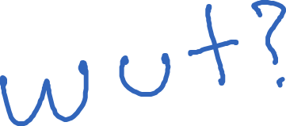
Naming Stuff - Variables
This is part of lines 110 to 124 from a module one of my modules
if ($PSCmdlet.MyInvocation.BoundParameters['Verbose'].IsPresent)
{
$a.Add('Verbose',$true)
$something = @{'Verbose'=$true}
}
$guy = @()
Get-TransportService @something |
ForEach-Object -Process {
$guy += Get-MessageTrackingLog -Server $_.Name @a
}

Slide 7

Naming Stuff - Variables
Here’s what it actually looks like – descriptive and camelCase
if ($PSCmdlet.MyInvocation.BoundParameters['Verbose'].IsPresent)
{
$searchParams.Add('Verbose',$true)
$getTransportParams = @{'Verbose'=$true}
}
$results = @()
Get-TransportService @getTransportParams |
ForEach-Object -Process {
$results += Get-MessageTrackingLog -Server $_.Name @searchParams
}

Slide 8
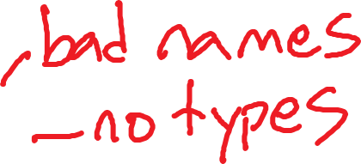


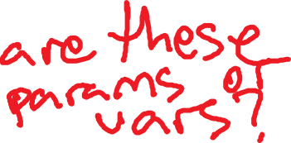
Naming Stuff - Parameters
Here’s a useless function to play with
function Write-Position
{
param
(
$firstbase,
$secondbase,
$thirdbase
)
write-output "On first base: $firstbase"
write-output "On second base: $secondbase"
write-output "On third base: $thirdbase"
}

Slide 9



Naming Stuff - Parameters
It should be like this
function Write-Position
{
param
(
[string]$FirstBase,
[string]$SecondBase,
[string]$ThirdBase
)
write-output "On first base: $FirstBase"
write-output "On second base: $SecondBase"
write-output "On third base: $ThirdBase"
}

Slide 10
Naming Stuff - Aliases
Let’s play “What’s this command do?”
gal |? def* -match sort
Get-Alias | Where-Object { $_.Definition -match 'sort' }
1..10 |%{ni "c:\temp\$_.txt"}
1..10 | ForEach-Object { New-Item "c:\temp\$_.txt" }
gsn |? name -eq 'server' |ipsn
Get-PSSession | Where-Object { $_.name -eq 'server' } | Import-PSSession

Slide 11
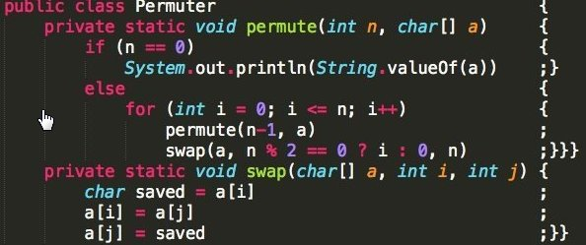
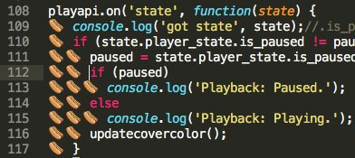




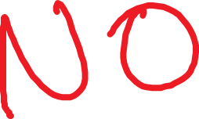



Brackets

Slide 12
Brackets
Cuddling
if ($test) {
Do-Something
} else {
Do-SomethingElse
}
Something In Between
if ($test) {
Do-Something
}
else {
Do-SomethingElse
}
New Lines
if ($test)
{
Do-Something
}
else
{
Do-SomethingElse
}
One problem with this one

Slide 13
Brackets
Consider these two examples – should return 5, 4, 3, 2, 1
1..5 | sort
{
10 - $_
}
Returns 1, 2, 3, 4, 5
1..5 | sort {
10 - $_
}
Returns 5, 4, 3, 2, 1

Slide 14
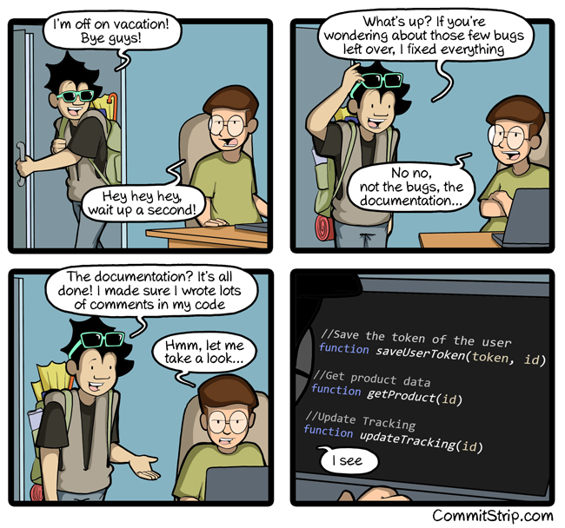
Inline Documentation
http://www.commitstrip.com/en/2016/07/27/documentation-just-before-vacation/

Slide 15
Inline Documentation
Consider this PowerShell code
$dayOfWeek = $null
$dayOfWeek = (Get-Date).DayOfWeek
Write-Output $dayOfWeek
Is this good?
$dayOfWeek = $null #Holds the day of week
#Get the date and assign the day of week to $dayOfWeek
$dayOfWeek = (Get-Date).DayOfWeek
#Write the day of week to the output stream
Write-Output $dayOfWeek

Slide 16
Inline Documentation
How about that example from my module earlier
Write-Verbose -Message 'Checking if Verbose switch is set'
if ($PSCmdlet.MyInvocation.BoundParameters['Verbose'].IsPresent)
{
Write-Verbose -Message 'Adding Verbose = true to search parameters because it is not set to null'
$SearchParams.Add('Verbose',$true)
$GetTransportParams = @{'Verbose'=$true}
} #if verbose flag is set
Write-Verbose -Message 'Getting transport service which will identify all servers in environment'
$results = @()
Get-TransportService @GetTransportParams |
ForEach-Object -Process {
Write-Verbose -Message "Checking $($_.Name)"
$results += Get-MessageTrackingLog -Server $_.Name @SearchParams
} #foreach-object in get-transportservice

Slide 17
Validating Parameters
Consider this function
function Get-DayOfWeek
{
param
(
$DateToCheck
)
Write-Output $DateToCheck.DayOfWeek
}
What if I put in a bad value for $DateToCheck?

Slide 18

Validating Parameters
Wrong type
Get-DayOfWeek 'omg not a date'
Nothing gets returned, not very helpful
Easy fix!
param
(
[DateTime]$DateToCheck
)

Slide 19
Validating Parameters
Now what happens?
Get-DayOfWeek 'omg not a date'
Get-DayOfWeek : Cannot process argument transformation on parameter 'DateToCheck'. Cannot convert value "omg not a date" to type "System.DateTime".
Error: "The string was not recognized as a valid DateTime. There is an unknown word starting at index 0."
At line:1 char:15
+ Get-DayOfWeek 'omg not a date'
+ ~~~~~~~~~~~~~~~~
+ CategoryInfo : InvalidData: (:) [Get-DayOfWeek], ParameterBindingArgumentTransformationException
+ FullyQualifiedErrorId : ParameterArgumentTransformationError,Get-DayOfWeek

Slide 20
Off Topic
Scared of red error text of doom?
$host.PrivateData.ErrorForegroundColor = 'green‘
Now the errors aren’t so scary
Get-DayOfWeek 'omg not a date'
Get-DayOfWeek : Cannot process argument transformation on parameter 'DateToCheck'. Cannot convert value "omg not a date" to type "System.DateTime".
Error: "The string was not recognized as a valid DateTime. There is an unknown word starting at index 0."
At line:1 char:15
<output truncated>

Slide 21
Validating Parameters
What if I only want to support historical dates?
Get-DayOfWeek (Get-Date).AddDays(-2)
Tuesday
Get-DayOfWeek (Get-Date).AddDays(2)
Get-DayOfWeek : Cannot validate argument on parameter 'DateToCheck'. The "$_ -lt (Get-Date)" validation script for the argument with value "10/22/2016
11:21:49 AM" did not return a result of True. Determine why the validation script failed, and then try the command again.
<output truncated>

Slide 22
Validating Parameters
How did I make that break?
param
(
[ValidateScript({$_ -lt (Get-Date)})]
[DateTime]$DateToCheck
)

Slide 23
Validating Parameters
Other ways to validate parameters
[ValidateScript({$_ -lt (Get-Date)})]
[ValidatePattern(<#Regex here#>)]
[ValidateSet('Thing one','Thing two')]
Also ValidateNotNull, ValidateNotNullOrEmpty, ValidateLength, ValidateCount, ValidateRange

Slide 24
Modularization
What good is code that you can’t reuse?
$files = Get-ChildItem -Path 'c:\temp\demo'
foreach ($file in $files)
{
if ($file.LastWriteTime -lt (Get-Date).AddDays(-3))
{
Move-Item $file 'c:\temp\archive'
}
}

Slide 25
Modularization
Why not just do this?
function Move-OldFiles {
param (
[string]$Source,
[string]$Destination,
[datetime]$Age
)
$files = Get-ChildItem -Path $Source
foreach ($file in $files) {
if ($file.LastWriteTime -lt $Age) {
Move-Item $file $Destination
}
}
}

Slide 26
Testing for Speed
I want to get “@ string !” out of this string
$string = 'some @ string ! with & symbols'
Which is faster?
$splitOnSpace = $string -split ' '
$splitOnSpace[$($splitOnSpace.IndexOf('@'))..$($splitOnSpace.IndexOf('!'))] -join ' ‘
Or
[regex]::matches($string,'@ string !').value

Slide 27
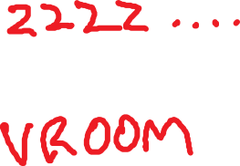
Testing For Speed
Use Measure-Command
(measure-command {$splitOnSpace = $string -split ' '
$splitOnSpace[$($splitOnSpace.IndexOf('@'))..$($splitOnSpace.IndexOf('!'))] -join ' '}).ticks
56659
(measure-command {[regex]::matches($string,'@ string !').value}).ticks
25651

Slide 28
Testing For Speed
Here’s why you validate parameters (both throw errors)
function Test-Function {
param (
[string]$TestString
)
if ($TestString -ne 'bear attack') {
Write-Error 'TestString must be equal to "bear attack"'
}
Start-Sleep 3
Write-Output $TestString
}
(measure-command {Test-Function -TestString 'wrong'}).ticks
32,250,265

Slide 29
Testing For Speed
Here’s why you validate parameters (both throw errors)
function Test-Function {
param (
[ValidateSet('bear attack')]
[string]$TestString
)
Start-Sleep 3
Write-Output $TestString
}
(measure-command {Test-Function -TestString 'wrong'}).ticks
2,130,397

Slide 30


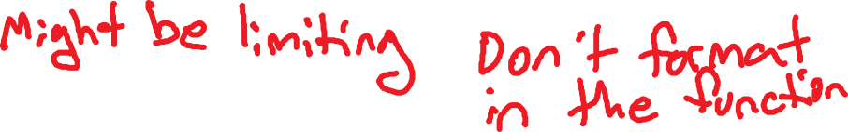

Returning Stuff
What’s wrong with this?
function Get-FileInfo {
param (
[string]$File
)
$fileInfo = Get-Item $File
$fileInfo | select Name,FullName,LastWriteTime | Format-List
}

Slide 31
Returning Stuff
The right way
function Get-FileInfo {
param (
[string]$File,
[ValidateSet('LinkType', 'Mode', 'Target', 'PSChildName', 'PSDrive',
'PSIsContainer', 'Name')] #Left some valid properties out for space
[string[]]$InterestingParams
)
$fileInfo = Get-Item $File
$fileInfo | select -property $InterestingParams
}
Get-FileInfo -File 'C:\temp\8.txt' -InterestingParams 'Name','PSIsContainer' | fl

Slide 32
Returning Stuff
Building that ValidateSet looked like a lot of work
But it wasn’t
(get-item C:\temp\8.txt |
get-member |
where { $_.membertype -match 'property' }).name -join "', '" |
set-clipboard
Use “-match ‘property’” to also get AliasProperty and ScriptProperty

Slide 33
Recap
Take care in how you format your code
Naming
Brackets
Using aliases
Document your code inline
Not too much
Not too little
Validate your parameters
Think modularly
Test for speed and efficiency
Return one object

Slide 34
Why do you want to write non-sucky PowerShell?
Be nice to the next guy
Sharing is caring
Scripting is a craft
You’re a professional
If it’s worth doing, it’s worth doing right
This is not a comprehensive guide. Just 6 things you should do.

Slide 35
Connect with me
@MrThomasRayner
LinkedIn.com/in/thomasrayner
workingsysadmin.com
Check out my user group
@EMUGca
Emug.ca

